Slide 1
Introducing Symfony
Composer, Bundles, Symfony Framework

Slide 2
Table of Contents
Introducing Symfony
Install Symfony
Symfony Installer
Composer
Symfony Overview

Slide 3
Introducing Symfony
Advantages of The Framework

Slide 4

Introducing Symfony
MVC Architecture
Scalability
Great Set of Components
Active community
Good documentation

Slide 5
Install & Configure Symfony
Symfony Installer & Composer

Slide 6
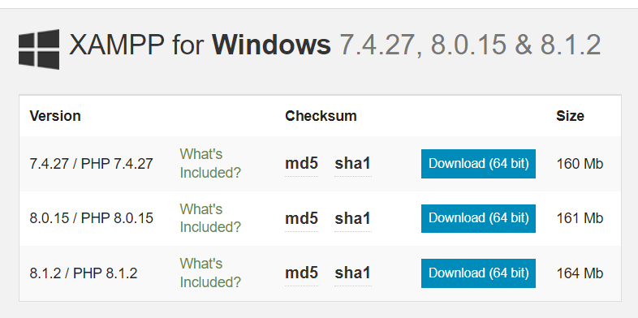
Download XAMPP

Slide 7

Composer
To install Composer go to https://getcomposer.org/download/ and follow instructions.

Slide 8
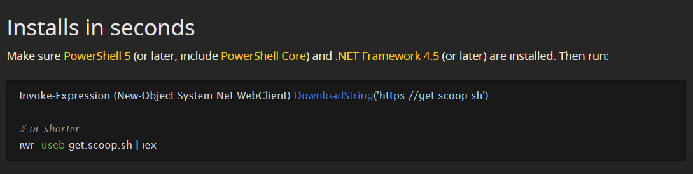
Install Scoop

Slide 9
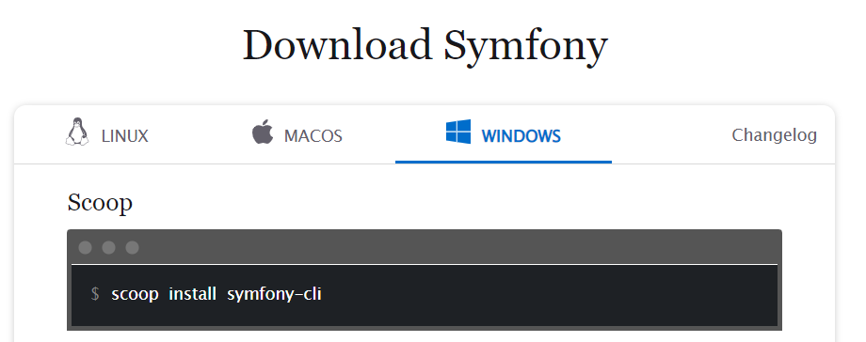
Install Symfony
Install Symfony: go to https://symfony.com/download

Slide 10
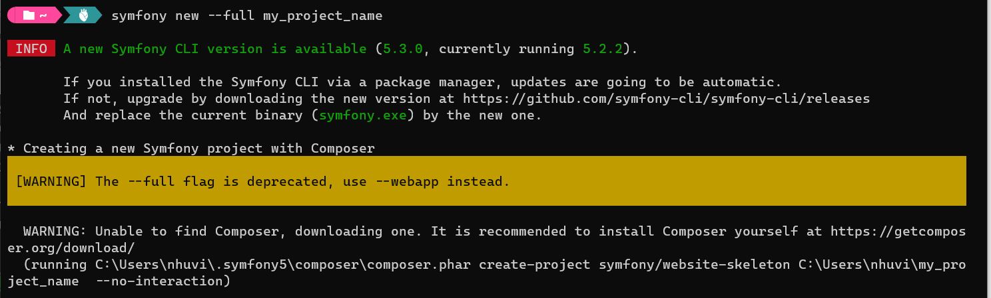
Symfony Installer
To install, execute:
symfony new --full my_project_name

Slide 11
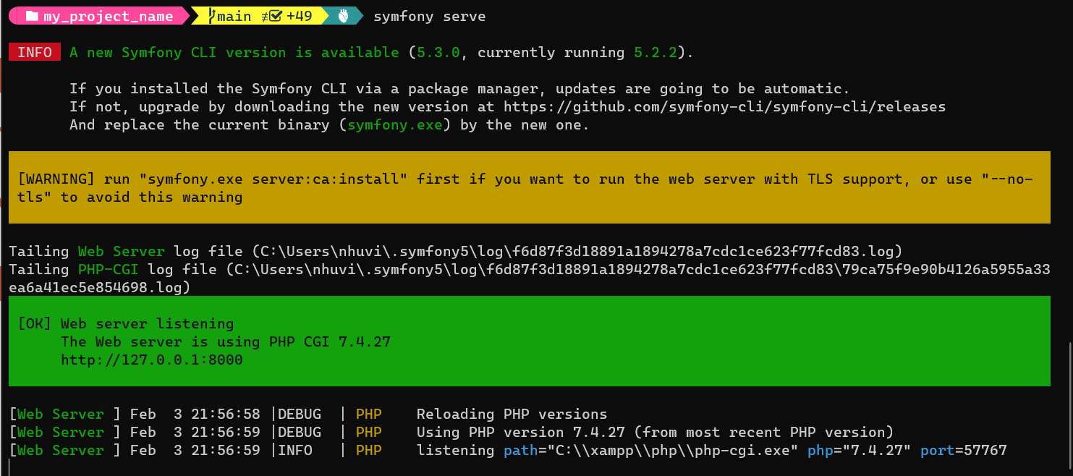
Run Symfony
cd my_project_name/
symfony serve

Slide 12
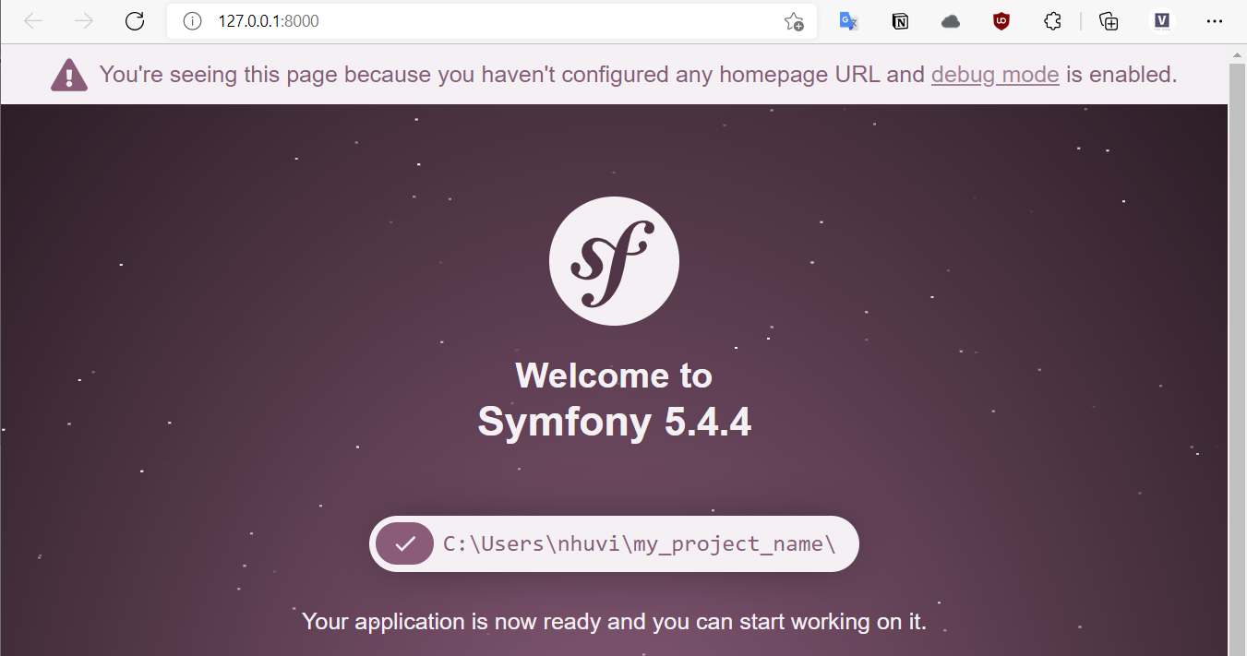
Run Symfony

Slide 13
Symfony Overview
First Steps With The Framework

Slide 14
The Bundle System
What is a Bundle?
set of files within a directory designed to implement a single feature
each bundle has its own namespace
\<Vendor Name>\(<Namespace>\)*<Class Name>
$ php bin/console generate:bundle

Slide 15
The Bundle System
The bundle class name must follow five simple rules:
Use only alphanumeric characters and underscores;
Use a CamelCase name;
Use a descriptive and short name (no more than two words);
Prefix the name with the concatenation of the vendor (and optionally the category namespaces);
Suffix the name with Bundle.

Slide 16
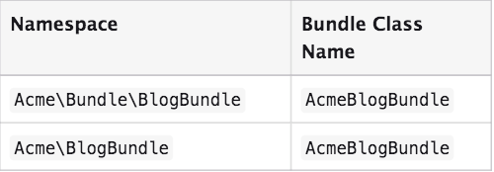
The Bundle System
Example of valid bundle names:

Slide 17
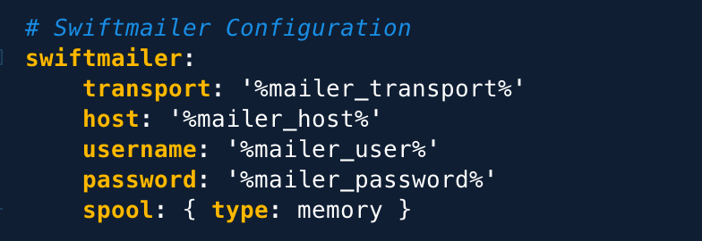
YAML - YAML Ain’t Markup Language!
YAML is:
human-readable data serialization language like json and xml, but easier to read
based on key: value used for Symfony configuration

Slide 18
Directory Structure
Directory | Description
app/ | Application Kernel (AppKernel) and main configuration files in config/ directory
bin/ | Symfony console
src/ | the project’s code
tests/ | automatic(unit) tests

Slide 19
Directory Structure
Directory | Description
var/ | logs and cache files
vendor | third-party dependecies (bundles)
src/ | the project’s code
web/ | web root directory, application index

Slide 20
Symfony Project Overview
src/Kernel.php
Is the most important file of our project
All bundles are registered/activated in Kernel
class Kernel extends BaseKernel
{
public function registerBundles()
{
$contents = require $this->getProjectDir().'/config/bundles.php';
foreach ($contents as $class => $envs) {
if ($envs[$this->environment] ?? $envs['all'] ?? false) {
yield new $class();
}
}
}
}

Slide 21
Symfony Project Overview
src/Kernel.php
AppKernel also provides configuration for different environments
class Kernel extends BaseKernel {
public function registerBundles()
{
$contents = require $this->getProjectDir().'/config/bundles.php';
foreach ($contents as $class => $envs) {
if ($envs[$this->environment] ?? $envs['all'] ?? false) {
yield new $class();
}
}
}
}
Each environment should have its own config file suffixed with the name of the provided environment, e.g.: config_dev.yml
Each environment creates its own cache and log files in var/cache and var/log

Slide 22
Symfony Project Overview
app/config/routes.yaml
Contains mapping between controllers and routes
# This file is the entry point to configure your own HTTP routes.
# Files in the routes/ subdirectory configure the routes for your dependencies.
#index:
# path: /
# defaults: { _controller: 'App\Controller\DefaultController::index' }

Slide 23
Symfony Project Overview
app/config/packages/security.yml
Authentication and authorization (access control) settings. Settings for password encoding, login form, roles, role hierarchy
# https://symfony.com/doc/current/security.html#where-do-users-come-from-user-providers
providers:
users_in_memory: { memory: null }
firewalls:
dev:
pattern: ^/(_(profiler|wdt)|css|images|js)/
security: false
main:
anonymous: true
provider: users_in_memory
# activate different ways to authenticate
# https://symfony.com/doc/current/security.html#firewalls-authentication
# https://symfony.com/doc/current/security/impersonating_user.html
# switch_user: true
# Easy way to control access for large sections of your site
# Note: Only the *first* access control that matches will be used
access_control:
# - { path: ^/admin, roles: ROLE_ADMIN }
# - { path: ^/profile, roles: ROLE_USER }

Slide 24
Symfony Project Overview
app/config/services.yml
Configuration for different services and bundles
parameters:
services:
# default configuration for services in *this* file
_defaults:
autowire: true # Automatically injects dependencies in your services.
autoconfigure: true # Automatically registers your services as commands, event subscribers, etc.
public: false # Allows optimizing the container by removing unused services; this also means
# fetching services directly from the container via $container->get() won't work.
# The best practice is to be explicit about your dependencies anyway.

Slide 25
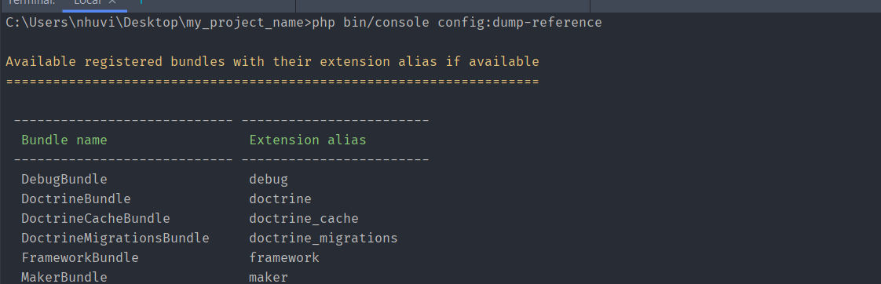
Symfony Project Overview
app/config/services.yml
Configuration for different services and bundles
Full project configuration:
php bin/console config:dump-reference

Slide 26
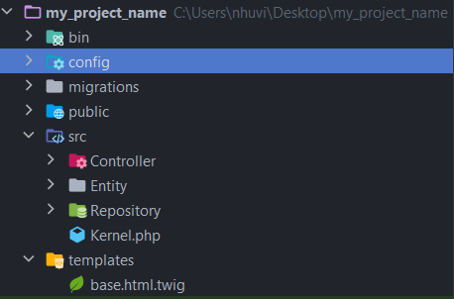
Symfony Project Overview
src/
Source folder of our Controllers, Entities, Repositories

Slide 27
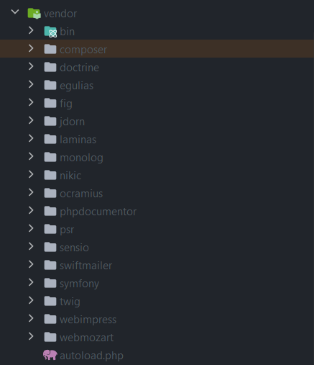
Symfony Project Overview
vendor/
Directory of all dependencies and external libraries used in our project.
Autoloading and dependencies are handled by Composer so we don’t need to do anything in this directory.

Slide 28
Summary
Install Composer and Symfony Installer
The Bundle system
YAML
Install Symfony and project structure

